Slide 1
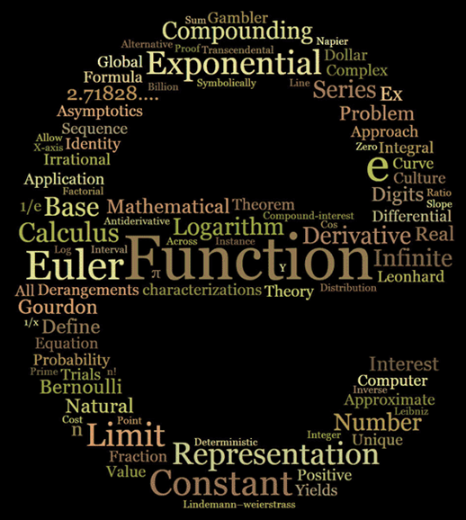
传奇e事 — e 粉情缘 rickjin

Slide 2
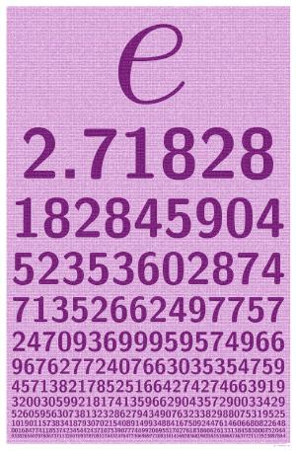
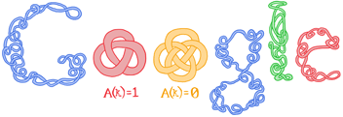
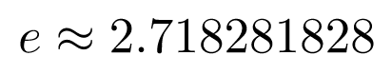
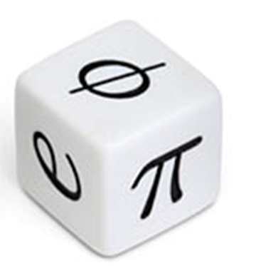
Google 是e的大粉丝

Slide 3
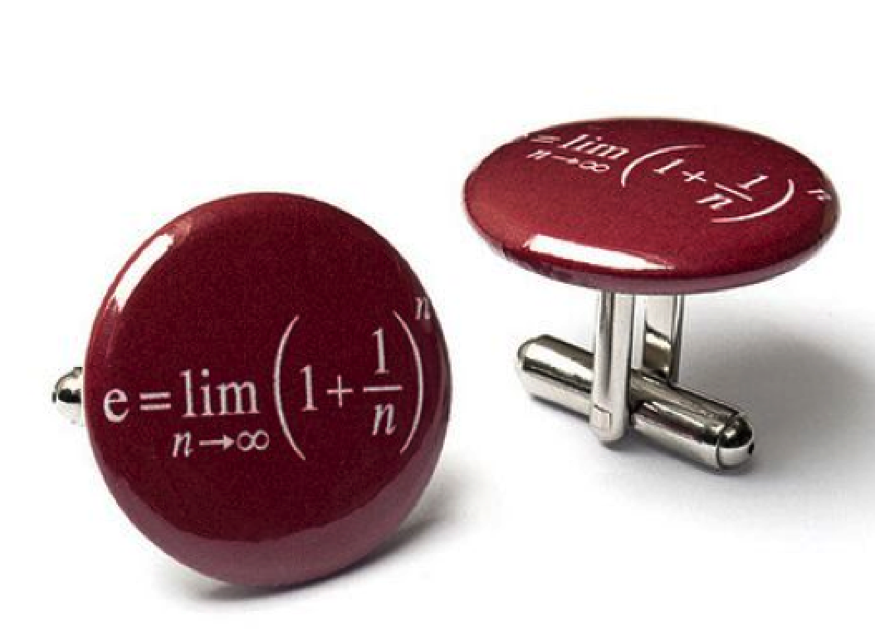
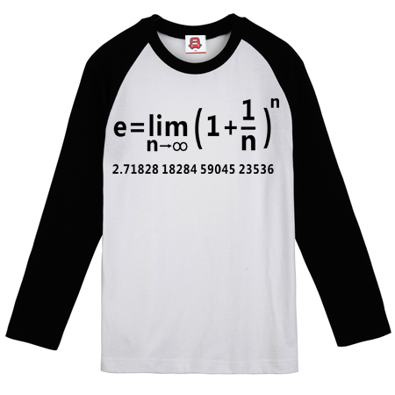
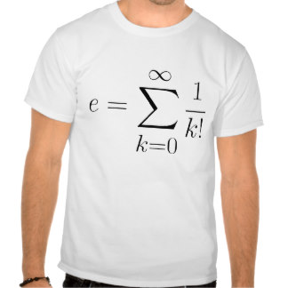
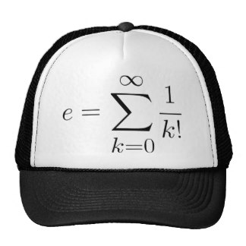
数学粉丝对 e 的钟爱

Slide 4
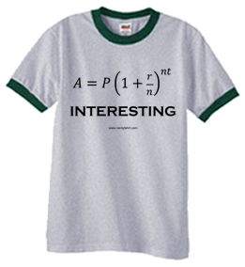
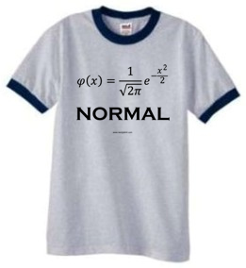
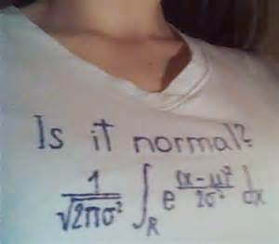
数学粉丝对 e 的钟爱

Slide 5
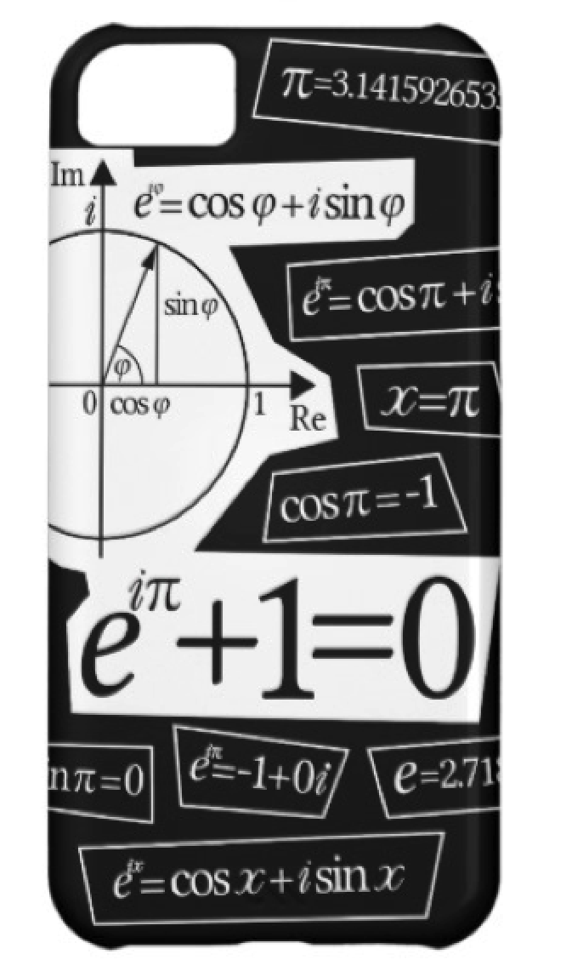
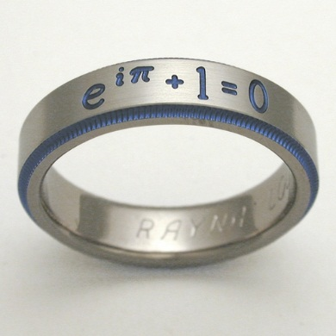
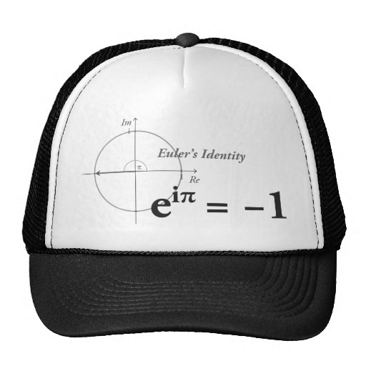
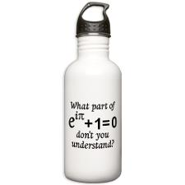
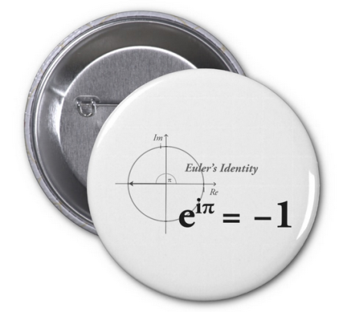
数学粉丝对 e 的钟爱
Notes:
如果内裤上有数学公式， 一定有不少数学粉丝会买

Slide 6
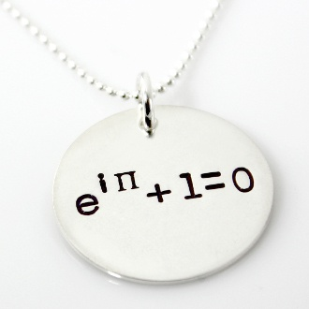
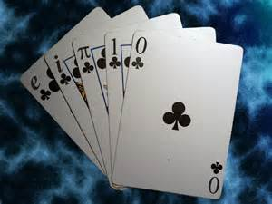
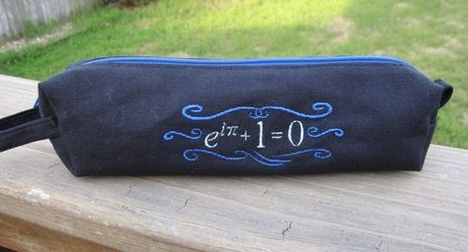
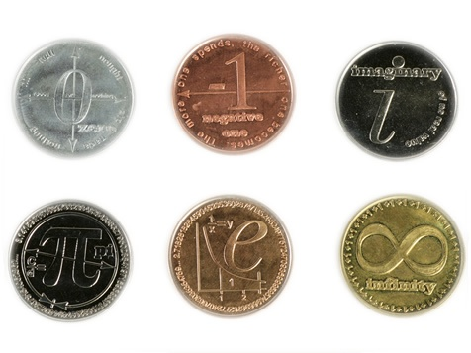
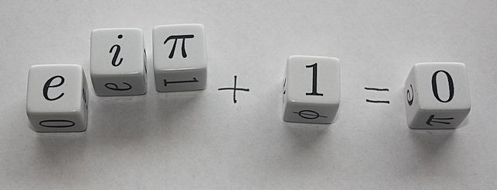

Slide 7
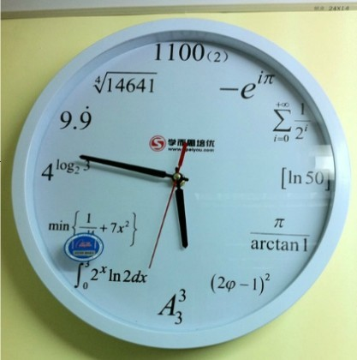
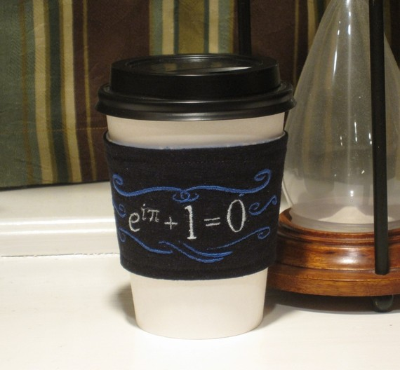
数学家就是把咖啡变成定理的机器
Notes:
数学家就是把咖啡变成定理的机器

Slide 8
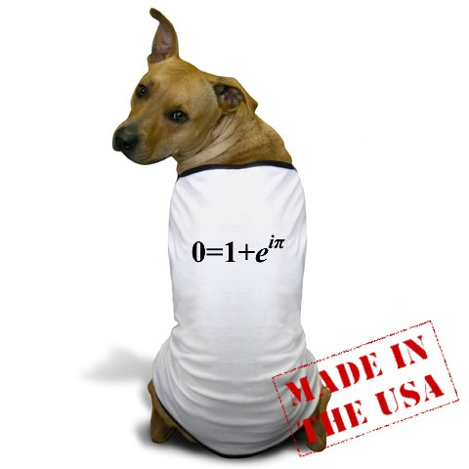
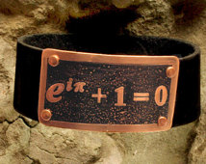
Notes:
这位狗狗的主人一定是位数学狂热粉丝

Slide 9
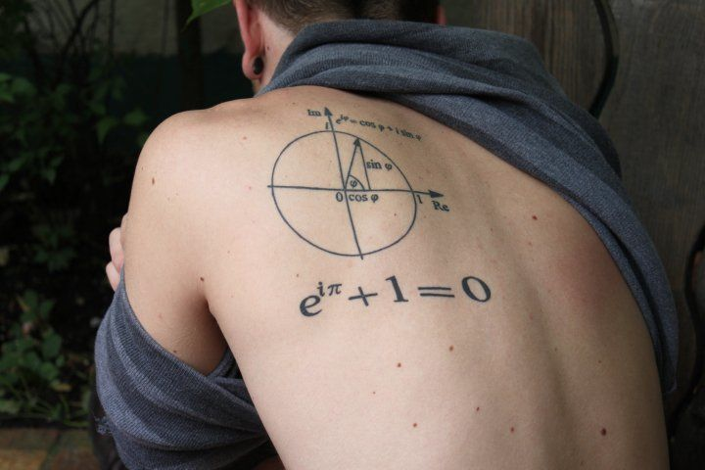

Slide 10
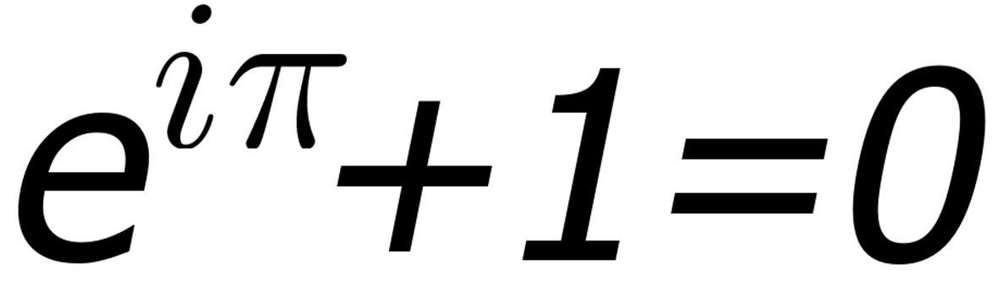
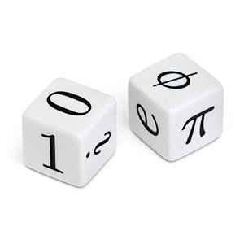
最美丽的数学公式 --- Euler Identity
五朵金花
各放异彩
天造地设
珠联璧合
Notes:
In 1988, a Mathematical Intelligencer poll voted Euler’s identity as the most beautiful feat of all of mathematics.
《数学信使》杂志将她评为最美的数学定理。2004年《物理世界》杂志，将她和麦克思韦方程组一起列为最伟大的等式。
In 1990, a Mathematical Intelligencer poll voted Euler’s identity as the most beautiful feat of all of mathematics.
《数学信使》杂志将她评为最美的数学定理。2004年《物理世界》杂志，将她和麦克思韦方程组一起列为最伟大的等式。
2 A poll of readers conducted by The Mathematical Intelligencer in 1990 named Euler's identity as the "most beautiful theorem in mathematics".[9] In anoth er poll of readers that was conducted by Physics World in 2004, Euler's identity tied with Maxwell's equations (of electromagnetism) as the "greatest eq uation ever".[10]
她端庄大方，秀外慧中，简洁包含着深刻。悬挂于巴黎发明宫数学陈列室的间墙，如莎士比
亚的十四行诗，达·芬奇的蒙娜丽莎，王羲之的兰亭集序，人人都可驻足欣赏，顶礼膜拜。
《数学信使》杂志将她评为最美的数学定理。2004年《物理世界》杂志，将她和麦克思
韦方程组一起列为最伟大的等式。
《欧拉神话般的公式》的作者，在书中称她为“数学美的典范”。
康斯坦斯·里德称她为“最卓越的数学公式”，而理查德·费曼把她唤作“欧
拉的宝石”。伟大的高斯更是语出惊人：“ 如果被告知这个公式的学生不能立即领略的风
采，这个学生将永远不会成为一流的数学家。”
Stanford University mathematics professor Keith Devlin has said, "like a Shakespearean sonnet that captures the very essence of love, or a painting that brings out the beauty of the human form that is far more than just skin deep, Euler's equation reaches down into the very depths of existence".^{[5]} And Paul Nahin, a professor emeritus at the University of New Hampshire, who has written a book dedicated to Euler's formula and its applications in Fourier analysis, describes Euler's identity as being "of exquisite beauty".^{[6]}
The mathematics writer Constance Reid has opined that Euler's identity is "the most famous formula in all mathematics".^{[7]} And Benjamin Peirce, a noted American 19th-century philosopher, mathematician, and professor at Harvard University, after proving Euler's identity during a lecture, stated that the identity "is absolutely paradoxical; we cannot understand it, and we don't know what it means, but we have proved it, and therefore we know it must be the truth".^{[8]}
A poll of readers conducted by The Mathematical Intelligencer in 1990 named Euler's identity as the "most beautiful theorem in mathematics".^{[9]} In another poll of readers that was conducted by Physics World in 2004, Euler's identity tied with Maxwell's equations (ofelectromagnetism) as the "greatest equation ever".^{[10]}

Slide 11
e: The Master of All
Read Euler, read Euler. He is the master of us all.
---P. S. de Laplace
Study e, study e. It is the master of all.
--- American Mathematic Monthly, B. J. McCartin

Slide 12
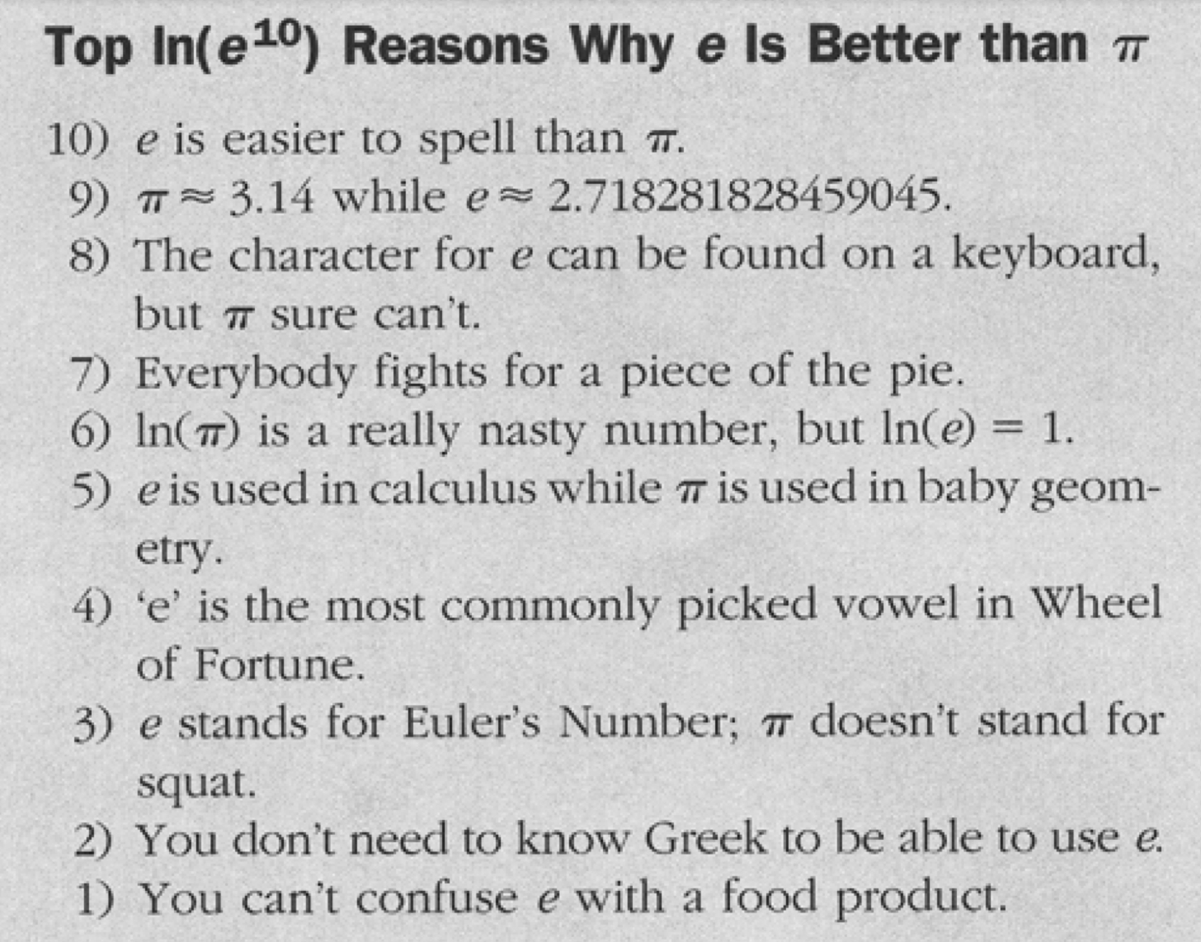


Slide 13
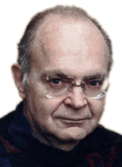

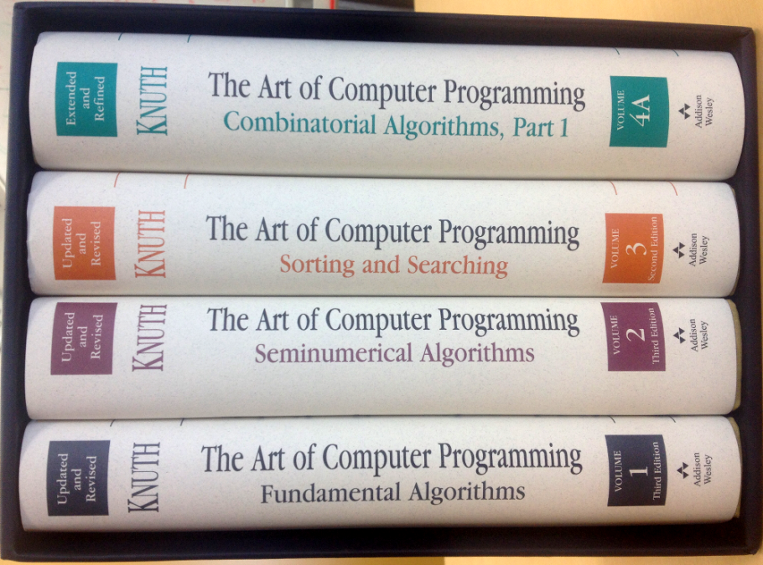

Donald E. Knuth(高纳德)
3, 3.1, 3.14, …,3.14159265
2, 2.7, 2.71, …, 2.7182818

Slide 14
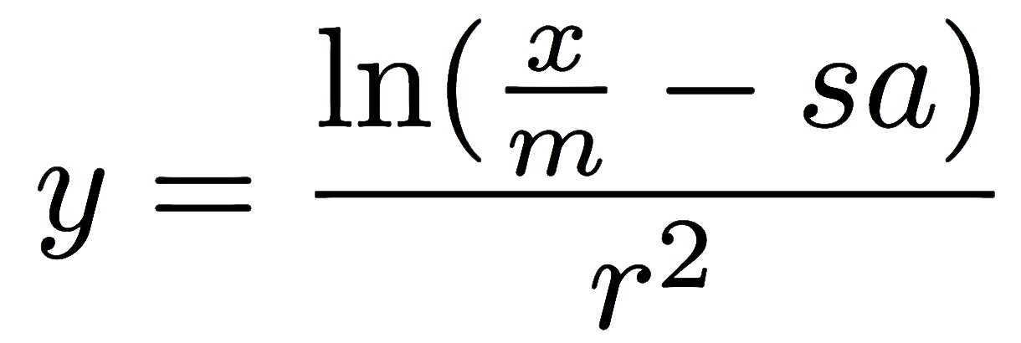

Slide 15
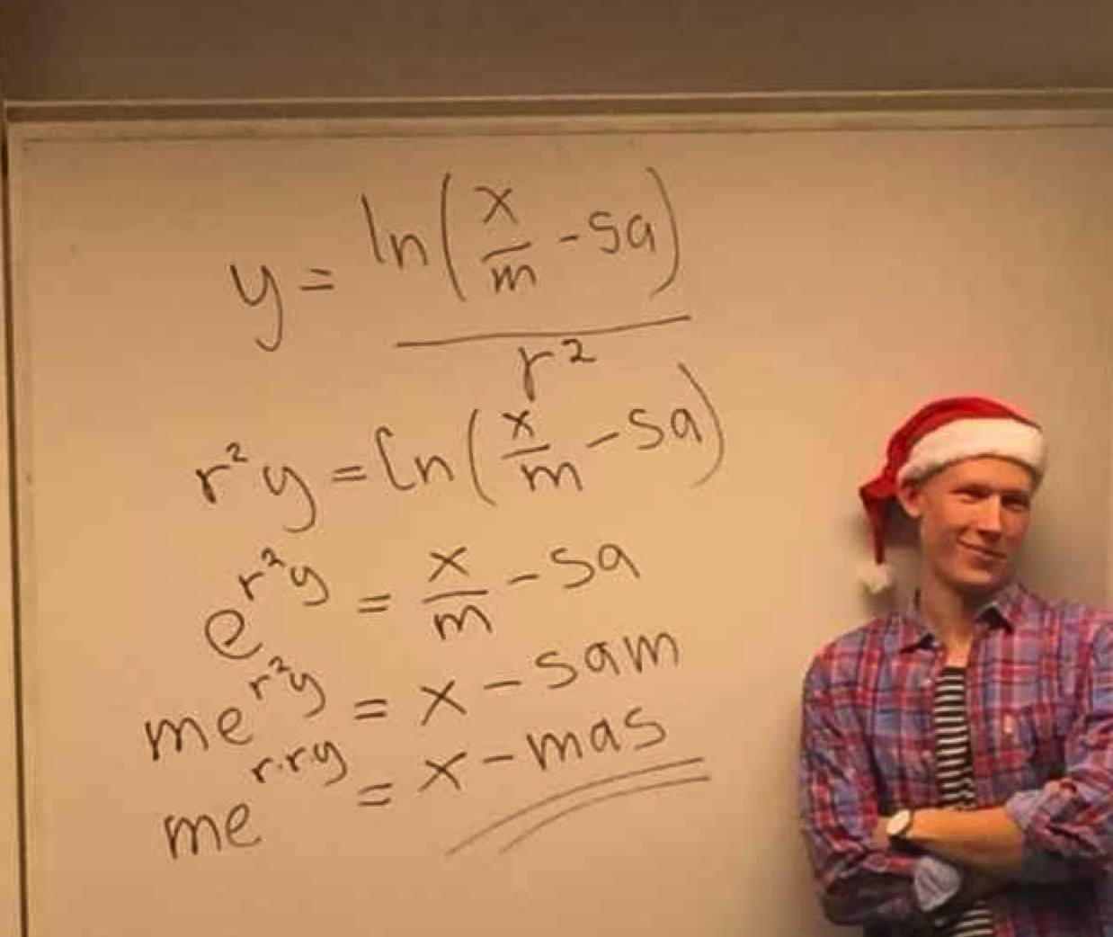
Merry Xmas!

